Slide 1
Elemental formula data evaluation from high resolution mass spectrometry
What is the quality of dissolved organic matter
Which sample from which origin (lake, river, sediment, aquaculture, waste water…) has which DOM quality
How is the DOM quality changed, along a river transsect, as function of time, after irradiation, as function of depth…
Which biogeochemical processes can be deduced from observed DOM quality changes

Slide 2
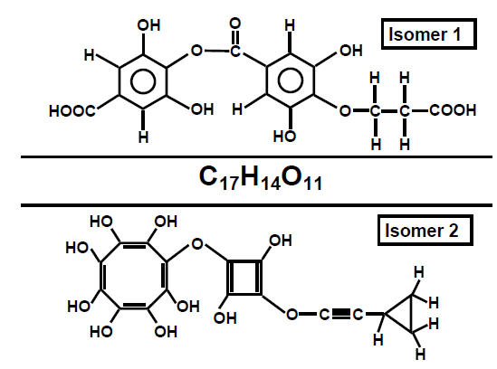
Limitation!
Only the elemental compositions, but not the isomeric structures can be detected by FTICR-MS
As an example, C₁₇H₁₄O₁₁ can stand for even millions of isomers. The upper structure, isomer 1 would represent indeed a humic like molecule. Isomer 2 seems not realistic at all to be part of the DOM pool. This molecule contains some chemical structure elements which can be assumed to do not exist in natural organic material. However it represents one of the enormous number of possible isomeric solutions of the given formula

Slide 3
The data evaluation technique is the key for understanding DOM biogeochemical processes
Single elemental formula data, the observation of the trajectories of DOM components with specific elemental composition sometimes tell more about processes than bulk descriptors (here samples from a flood event with discharge data)

Slide 4
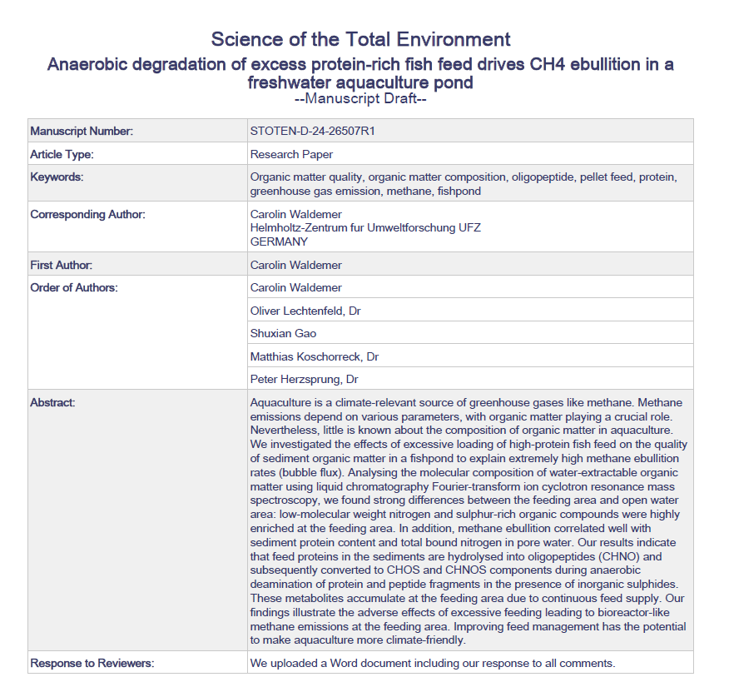
Accepted 9/23/2024

Slide 5
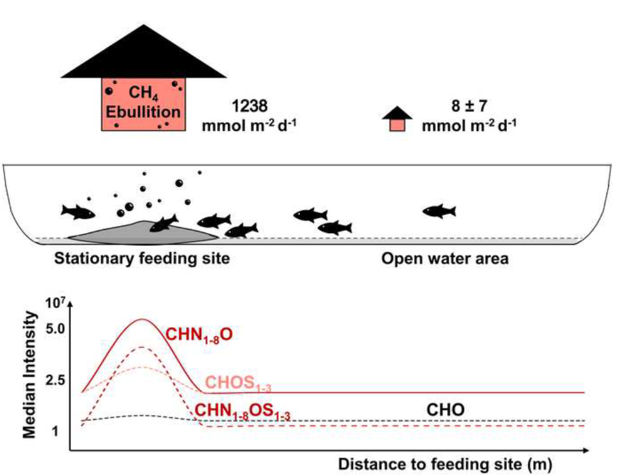
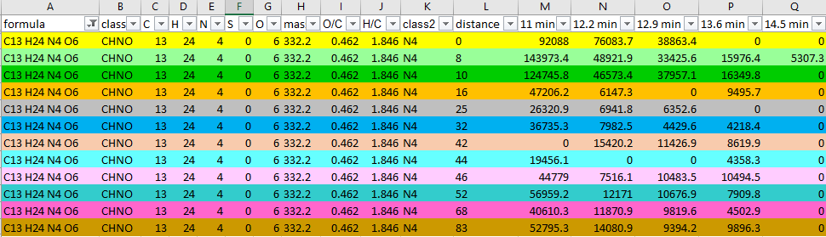

Slide 7
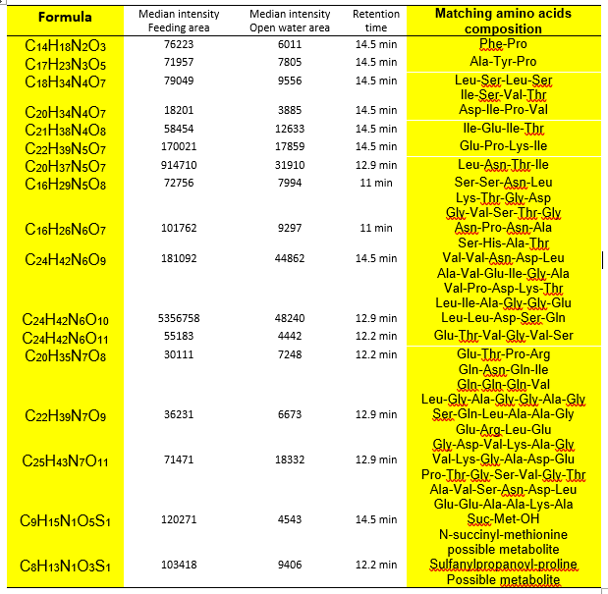

Slide 8
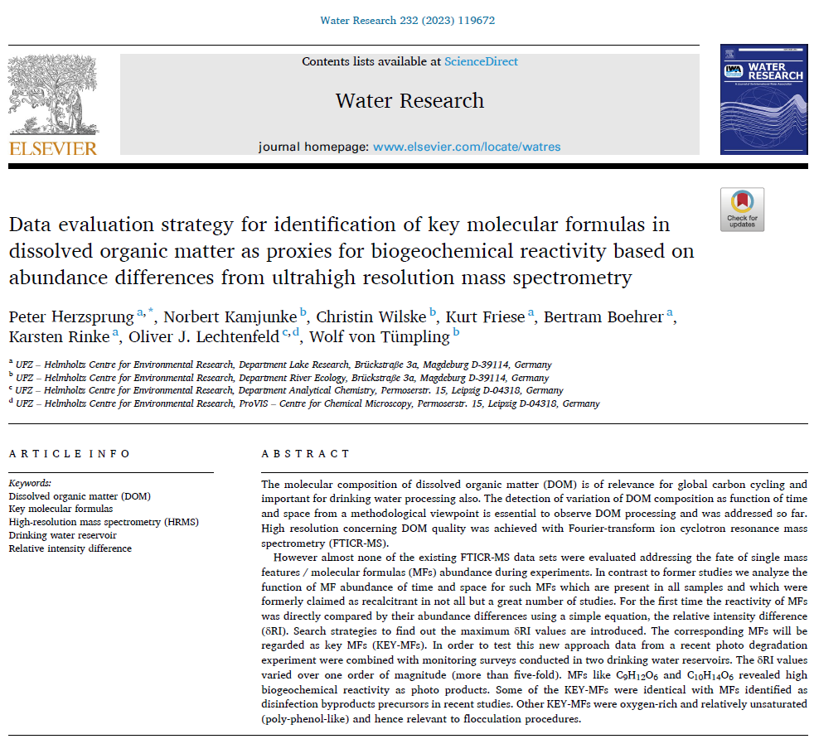
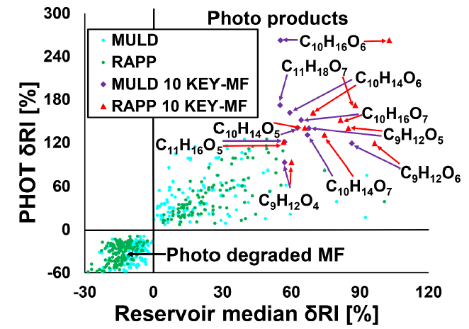

Slide 9
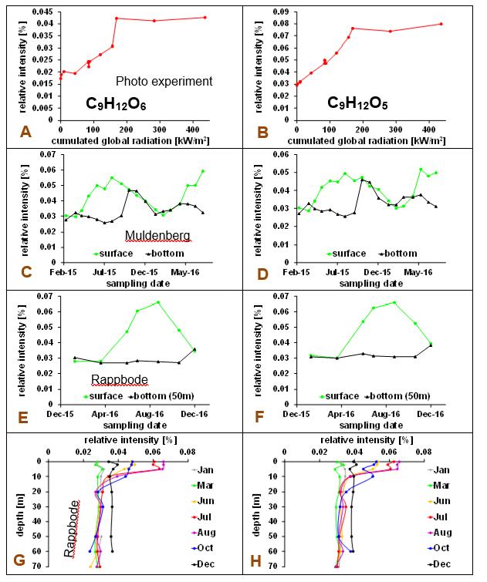

Slide 11
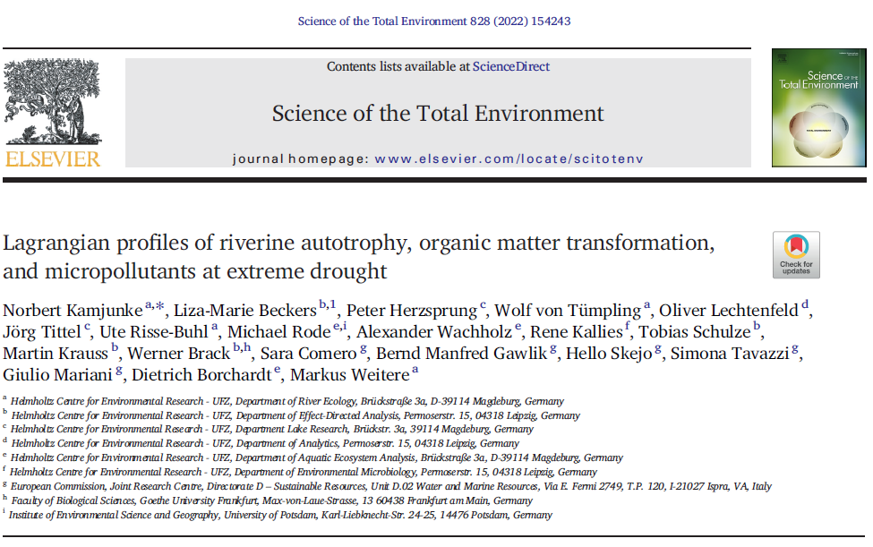

Slide 12
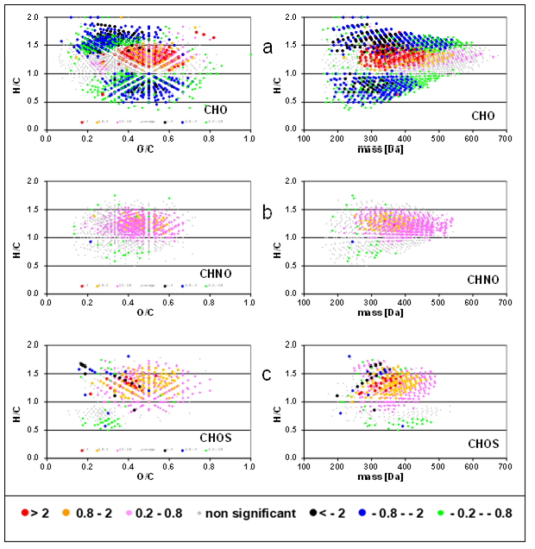
Slopes intensity versus distance

Slide 13

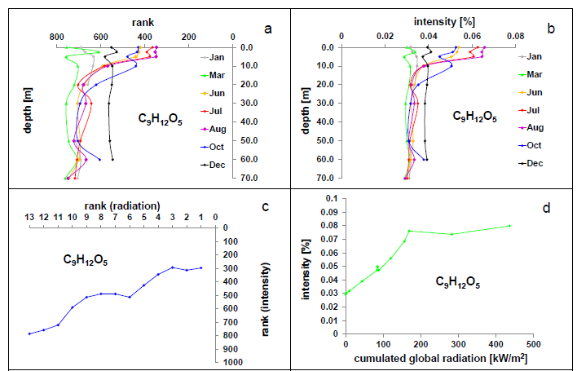

Slide 14
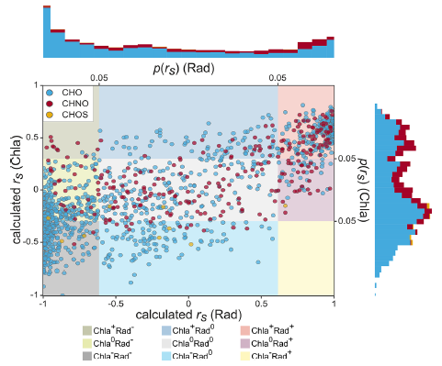
Rank correlation FTICRMS / Chlorophyll
Versus
Rank correlation FTICRMS / Radiation
Lake monitoring linked to photo degradation experiment

Slide 15

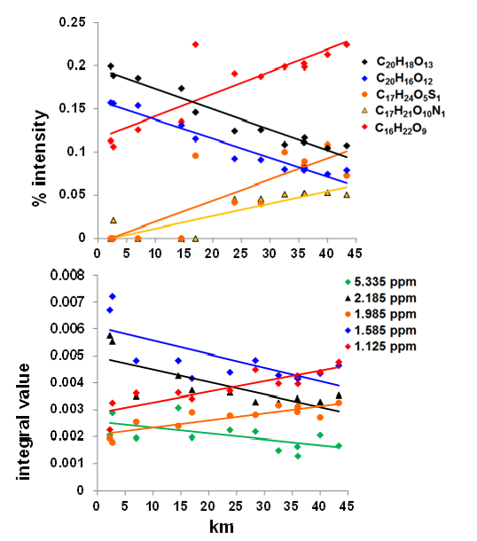
Combination of
FTICRMS
And ¹H-NMR

Slide 16
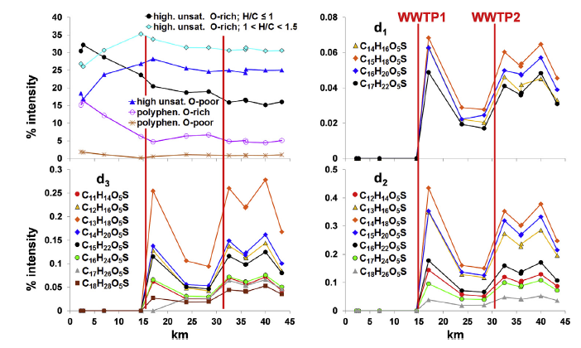
Waste water treatment plants →
Influence on CHOS abundance

Slide 17
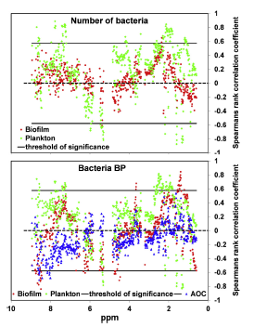
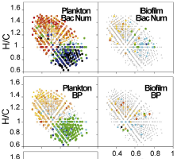
Linking of FTICR-MS and NMR to bacterial bio production

Slide 18

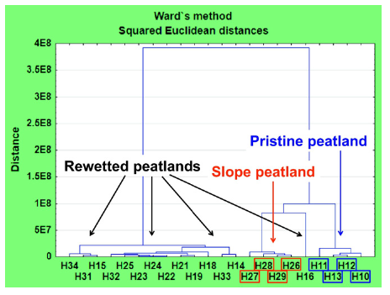

Slide 19
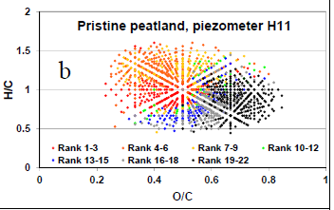
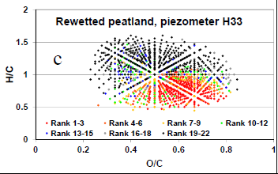
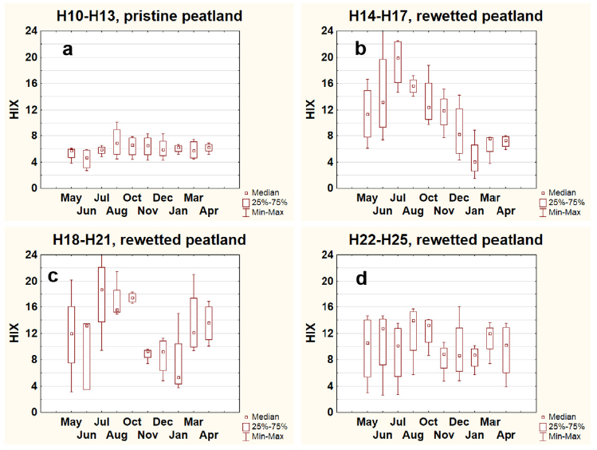
EEMF / fluorescence data can help, if a huge number of samples is required for observation of trends
→ Here differences in annual oscillations and homogenity / inhomogenity of sampling locations

Slide 20
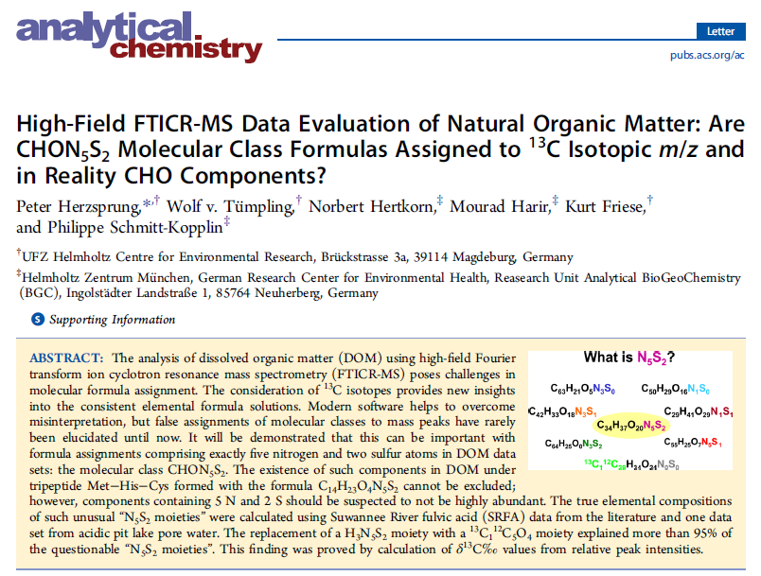
For instance, MFs with a ¹²C₅¹³C₁O₄ residual (e.g.,¹²C_{c}¹³C₁H_{h}N₀O_{o}S₀) could be also assigned with a H₃N₅S₂ residual
(¹²C_{c−5}¹³C₁₋₁H_{h+3} N₅O_{o−4}S₂) at a mass difference of only 0.026 mDa.

Slide 21
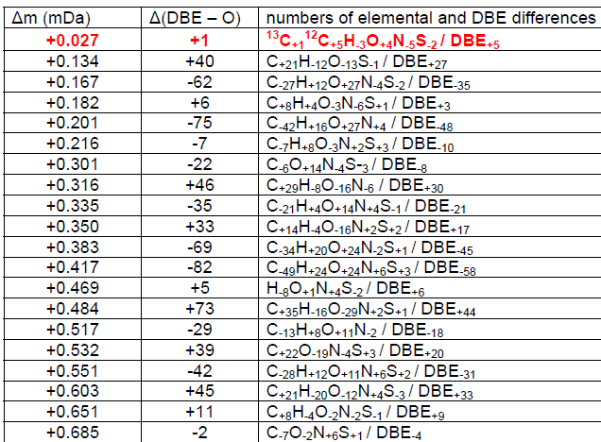

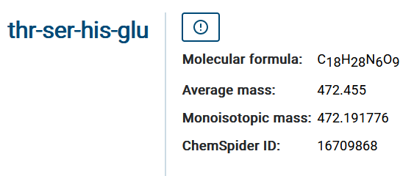
Formula assignment issues are important
Here unreliable CHOS₁ were found
and finally identified as CHN₆O

Slide 22
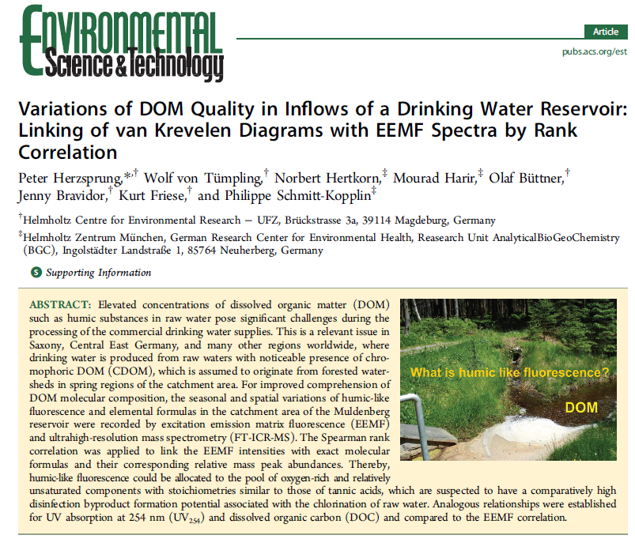
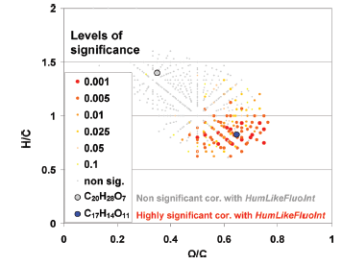
The UFZ in cooperation with Helmholtz Munich was in 2012 the first to evidence that polyphenol-like molecules are responsible for humic like fluorescence

Slide 23
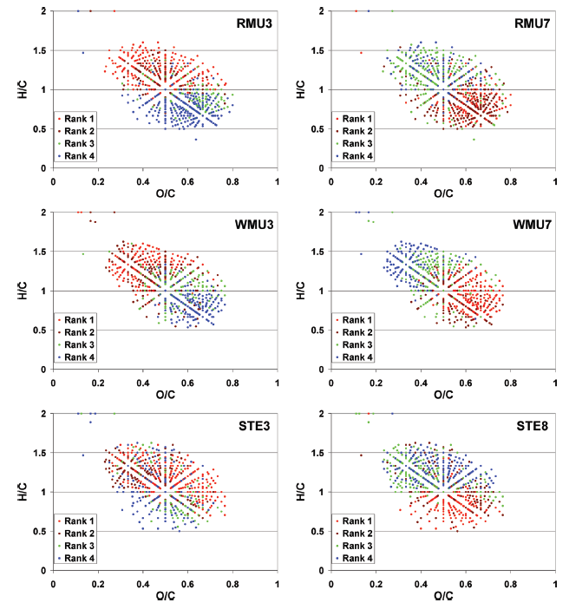
The inter sample ranking data evaluation technique had been introduced in this article

